Slide 1
Organizing Code:
Functions, Methods, & Modules
Session Seven

Slide 2
Reminders
Due Today
Due Next Week
Homework from Session Six
Quiz on Session Six Content
Homework from this session
Quiz on this session’s content
Notes:
We are cruising through our homeworks and quizzes here and as we are all accustomed to by now we will have both a homework due and a quiz.

Slide 3
Reminders
Due Today
Due Next Week
Homework from last session
Quiz on this session’s
Homework from this session
Quiz on this session’s content
Notes:
Next week you will have another homework due and a quiz on this session’s content.

Slide 4
Agenda / Topics
1. Start of Class & Quiz
2. Modules
3. Functions & Methods
4. Break
5. Security Topic
6. Overflow / Q&A / Dismissal
6:30 - 7:00
7:00 - 7:45
7:45 - 8:00
8:00 - 8:15
8:15 - 8:45
8:45 - 9:00

Slide 5
Follow-up on last week’s material:
Workload

Slide 6
Feedback received: The workload has ramped up a lot
There is unfortunately no way to learn programming or the basics of how to apply that skill to a technical discipline without a lot of time spent working on that skill. This will require a focused dedication especially from the students who have not done hands-on technical work before because it is a new style of work and learning.
Being frustrated and finding it really challenging is totally normal.
The absolute best way to make forward progress if you are feeling stressed will be to attend office hours.

Slide 7
Feedback received: Office Hours
We are going to hold office hours from 6:00pm - 8:30pm on Thursday.
We will see how this goes and then hope to keep up this schedule moving forward.

Slide 8
Q&A
?
Notes:
Any last-minute questions before the quiz?

Slide 9

Quiz
Access the quiz here:
https://forms.gle/818HLDPGx1uJ6fdA7
Screenshot before submitting & don’t refresh.
Notes:
Alright! Here’s the quiz. Please remember to screenshot or otherwise record your answers before you hit submit and don’t refresh! Google forms will drop your answers if your connection drops. Please be prepared.
https://forms.gle/818HLDPGx1uJ6fdA7

Slide 10
Functions

Slide 11
Functions
Input Data (optional)
Function
(code that does some stuff)
Rules:
You have to create / declare the function first before you try to call / use it.
You should use a different name in the function definition from the function call
Functions are general purpose and are not designed to only work on one specific piece of data.
Output Data (optional)

Slide 12
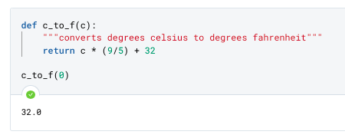
Functions
1
def keyword indicates declaration of a function
2
Whatever follows def is the function name
3
Parameters / arguments (more next slide)
Docstrings are a convention to explain what a function does
5
4
Indentation shows code that is run when the function is called (code that is in the function’s scope)
6
The keyword return tells the function to stop and return any data that follows it to where it was originally called
7
This is where we actually call the function. The object we want to call it on is in parentheses

Slide 13
Function Demo
Click to go to the demo notebook
Using VT and other libraries to make complex tasks easier

Slide 14
Methods
To skip a whole lot of stuff: methods are just functions that are specific to particular objects. They have to be called with dot notation.

Slide 15
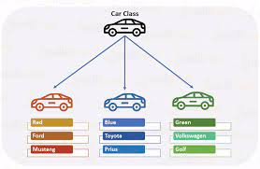
Object Oriented Programming: Classes

Slide 16
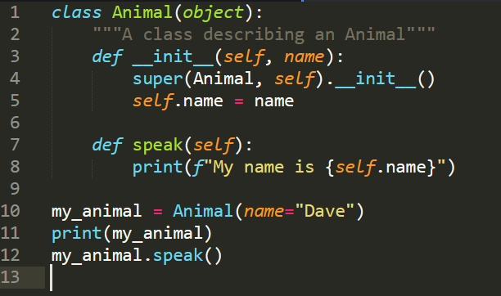
OOP: Anatomy of a Class
You will not have to write these, this is for background understanding only.
Our class name
Reserved keyword
Our class’ parent class
A “magic method” definition
An instance method definition
Creating a class instance

Slide 17
Examples of Methods
str.swapcase()
str.capitalize()
Calls code on a specified string to swap the case of the letter provided.
Capitalizes a string object
As we start to use third-party modules we are going to see more and more of these.
Remember that you can chain these in most cases:
str.swapcase().capitalize() etc.

Slide 18
Modules
Organizing code into thematic files.
Notes:
When we are programming, it’s often helpful to stay organized and to store code into different files. This makes it easier not only on us to remember where our code lives, but it also is important for making our code more useful to other people we might share it with.
If you recall from our previous discussion on the Zen of Python and the ethos for the language’s development, an important precept of Python is that it’s designed to be shareable and useful to other programmers. When someone talks about a language or a library or anything else as being “modular”, what they mean is that code is organized into blocks (think like legos) that are self-contained. Each module has all of - and only - the code that it needs for a specific purpose.
Designing code into these blocks allows for people to import - or bring in - just the code that will help them with each task they have. Keeping modules tight to a specific purpose helps ensure that there aren’t conflicts and that code can stay in small sizes when we need to import it or move it around during development.

Slide 19

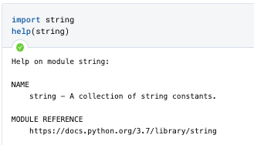
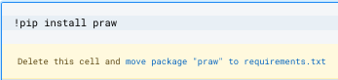
Working with Python Modules - most common sources
Create them Yourself
Use what comes with Python
Install with Pip
Create a file locally (or, in Deepnote, that’s uploaded to their service) that ends in .py. Once these are created and placed somewhere accessible to your development environment you can call import on the filename.
Vanilla Python has many additional modules in what is called the standard library. We’ll cover these after the midterm but you can find them in the docs now. These are installed by default so you can just import them.
Pip is the Python package manager, and you can use it to easily install packages from PyPI, the Python package index. When using pip with Deepnote, you’ll need to use an exclamation point. This will add it to requirements and download it if needed - and then you can import.

Slide 20
Import Statement Variations
Color Key
import pandas
import pandas as pd
from pandas import DataFrame, to_datetime
Don’t do this: from pandas import *
Keyword
Module Name
Module Contents (function, method, etc.)
Imports the entire module. Methods or objects will be called with: pandas.DataFrame()
Imports the entire module and assigns it a nickname. Some modules have conventional nicknames (this is one of them) that you should respect. Code called with pd.DataFrame()
Imports specific code from the specified module. Specified code can be called directly by its name with no prefix, e.g. DataFrame
This imports the entire module in such a way that you can call anything in it without specifying the source. This introduces a lot of code and can cause confusion in large projects.

Slide 21
Importing Demo
Click to go to the demo notebook
Using VT and other libraries to make complex tasks easier

Slide 22
Infosec Topic
Open Source Investigative Techniques
&
Operational Security

Slide 23
Open Source aka OSINT
Open Source Intelligence is more commonly called OSINT.
The term open source refers to information which could be accessed by anyone in the public without access to any specialized or proprietary tools.
This does not mean that all information can be accessed through a Google search. You may need to request the data, access it programmatically via an API, or identify sites which specialize in making that data easily accessible.
Notes:
The term “open source” refers specifically to information that is available to the general public. If any specialist skills, tools, techniques, or access are required to access a piece of information, it isn’t considered open source. While many people think of OSINT as being synonymous with content you can Google, there are many sources of OSINT material which may or may not be accessible readily online such as that which is:
Available to the public by request (for example, census data)
Available to the public by subscription or purchase (for example, industry journals)
Could be seen or heard by any casual observer
Made available at a meeting open to the public
Obtained by visiting any place or attending any event that is open to the public

Slide 24
Surface / Clear Web /Clearnet
Surface / Clear Web / Clearnet
What people mean when they say “the internet” but not actually the entire internet.
Portion of the world wide web (www) that is readily available to the public and searchable with standard web search engines.
What makes these sites searchable and others not?
These sites are crawled and indexed by a search engine such as Google.
Sites are indexable unless the developer puts in specific bit of code which tells Google not to index it or if the site requires a password.
Notes:
The surface or clear web are terms used interchangeably to mean what we are typically referencing when we say “the internet.” The clear web is accessible via the browsers we are all familiar with (Google, Bing, etc) and the sites on it are crawled and indexed regularly.
A note on indexing.
Website indexation is the process by which a search engine adds web content to its index. This is done by “crawling” webpages for keywords, metadata, and related signals that tell search engines if and where to rank content. Website indexing enables the search website such as Google to find a website, add it to its index, associate each page with searched topics, return this site on search engine results pages, and ultimately drive people to this content.
What you see on a search engine isn't the internet. It's the search engine's index of the internet. This is important because not every page published online is going to show up via a search engine.
It is very common for sites to include a robots.txt file which tells search engine crawlers which URLs the crawler can access on your site. This is used mainly to avoid overloading the site with requests; it is not a mechanism for keeping a web page out of Google.
Website owners can choose to block Google from indexing their content (which has the effect of blocking the page from search results) by making the site password protected or by including a “noindex” meta tag in the page’s HTML code.
Note: A web crawler is a bot which systematically browses the www and can be programmed to take actions as it does so (such as indexing information encountered).

Slide 25
Deep and dark web
Deep Web
Content on the internet which is not indexed and, therefore, not surfaceable by search engines.
Examples Include:
Anything behind a paywall or requiring sign-in credentials
Content that its owners have blocked web crawlers from indexing
Dark Web
Content which is intentionally hidden, encrypted, and requires a specific browser to access it.
To access dark web content you use:
Tor
The sites end in .onion
You need to know the sites you want to visit because search engines are poor and addresses are cryptic
Notes:
The “deep web” is a term used to refer to all of the websites, databases, files, and more that (for a variety of reasons, including the presence of login pages or paywalls) cannot be indexed by a search engine. Much of the content of the deep web can be considered open source because it’s readily available to the public.
In addition, there’s plenty of freely accessible information online that can be found using online tools other than traditional search engines. We’ll look at this more later on, but as a simple example, tools like Shodan and Censys can be used to find IP addresses, networks, open ports, webcams, printers, and pretty much anything else that’s connected to the internet.
The “dark” web is a subset of the deep web that is intentionally hidden, encrypted, and requires a specific browser, most commonly Tor, to access them.
Dark web search engines exist, but even the best are challenged and only surface a small subset of the content on the dark web. Typically, when using the dark web you need to know where to go and sites do not use the same syntax as they do on the clear web so are often far more crypticly named. For example, a popular ecommerce site called Dream Market goes by the unintelligible address of “eajwlvm3z2lcca76.onion.” There are website which maintain lists of dark web addresses, such as the Hidden Wiki, but they become out of date quickly.
There is nothing inherently illegal about the dark web and the dark web contains plenty of benign content. The Tor network began as an anonymous communications channel, and it still serves a valuable purpose in helping people communicate in restrictive environments. That said the dark web is known for being the home to nefarious and illegal content, which per research conducted by Thomas Rid is the majority of content on the dark web. [See this article for more in-depth coverage.]
These are important topics to understand as you learn OSINT tools and techniques because there are specific tools and techniques which work on the clear, depp, and dark nets.

Slide 26
Who uses OSINT Techniques and why?
Why do people and organizations use OSINT?
There is a massive amount of data which is available at our fingertips and often you do not need fancy access to conduct insightful investigations.
As previously discussed no one organization has all data and other companies often will not sell you their data and so you have to use open source data.
Notes:
Can a few people please raise their hand and volunteer the names of some organizations who use OSINT?
Answer:
Pretty much every industry which requires any form of research or investigations. To name just a few:
Journalists
Academics
Lawyers
Law enforcement
There are common tools which are associated with OSINT investigations:
Censys
Shodan
WolframAlpha
Nmap
HaveIBeenPwned
There are vendors who specialize in making tooling and producing intel leveraging OSINT:
Recorded Future
Silo Breaker
There are also vendors who specialize in obtaining information on the dark web and making it accessible to their customers:
Flashpoint

Slide 27
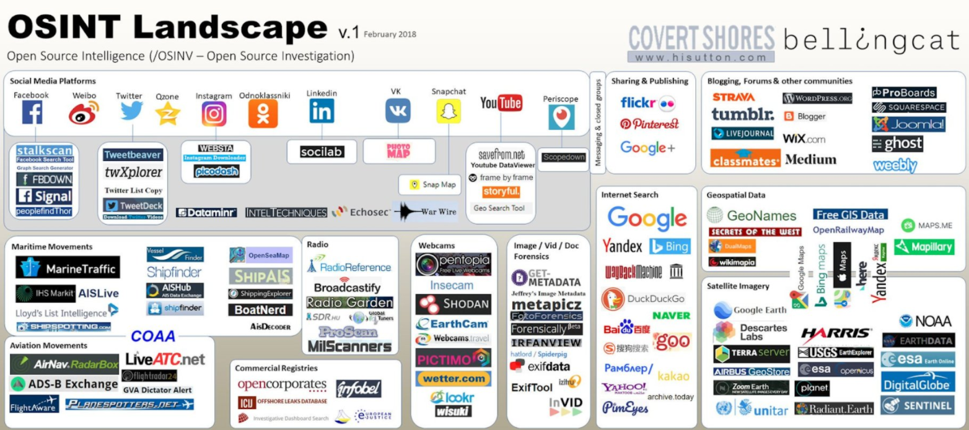
Data sources
Notes:
A lot of the work of a good OSINT investigator is to be familiar with niche data sources and tools which make data accessible.
For the homework this week we assigned you readings from Bellingcat which is a group of investigators who make advanced use of OSINT techniques to do awesome investigations. They are literally using the exact data sources everyone in this class has available to them to answer questions like “Is Ethiopia flying iranian-made armed drones?” and “Who or whom is behind the QAnon conspiracy theory drops?”
This image, provided by bellingcat, provides a list of tools which can be used to find data from popular websources. Highly recommend choosing one or two of these which you aren’t familiar with and poking around to see what is accessible to you.

Slide 28
OSINT Techniques
OSINT Techniques
Working with images
Geolocation
Accessing legal and government documents
Social media analysis
Search query manipulation
Notes:
There are tons of different OSINT techniques but some commons ones are understanding how to work with images, geolocation (boat tracking, plane tracking, metadata analysis, streetview usage, etc), legal documents, social media analysis, search query manipulation, and more.
One key aspect of OSINT tracking is thinking to use non-popular and non-US-centric tools to surface different data than everyone else will know to find. For example, different countries have different laws governing photo usage which enable some platforms to be better for image searching then others. Additionally, if you are looking for a Russian individual for example you may find them on Facebook since it is a large global platform but it is important to know that VK is a popular social media platform primarily used by individuals in Russia and former-Soviet countries. So, you want to be sure to understand and use local tools for research.
Today we will only have time to dip a toe into OSINT techniques. We are going to cover the super basics of reverse image search and google dorking.

Slide 29
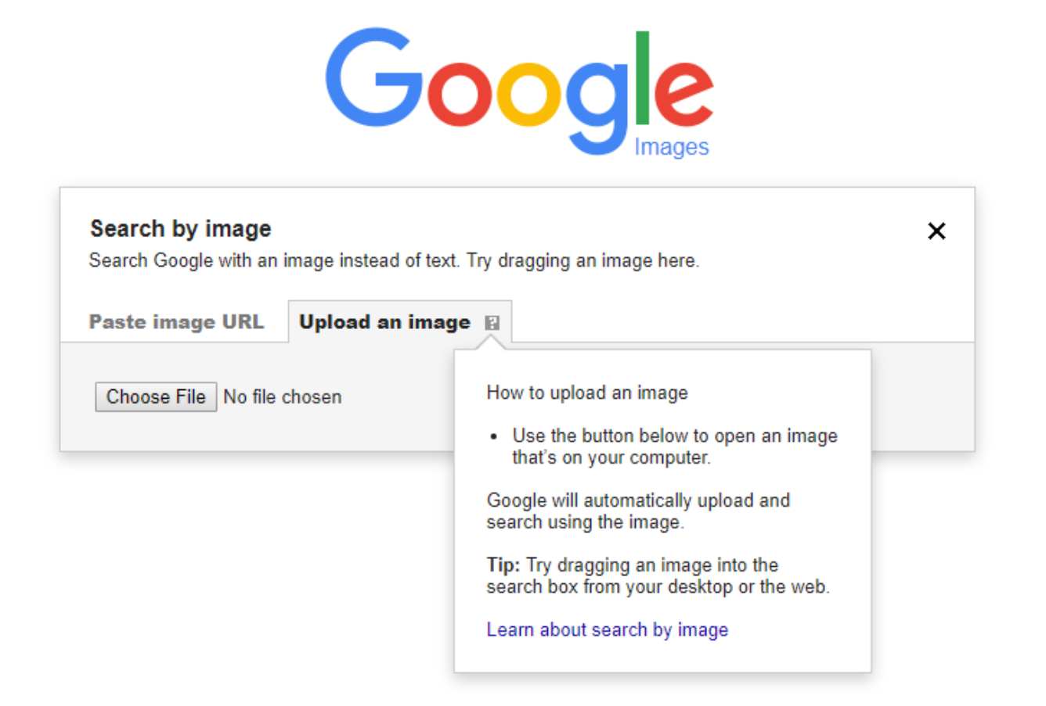
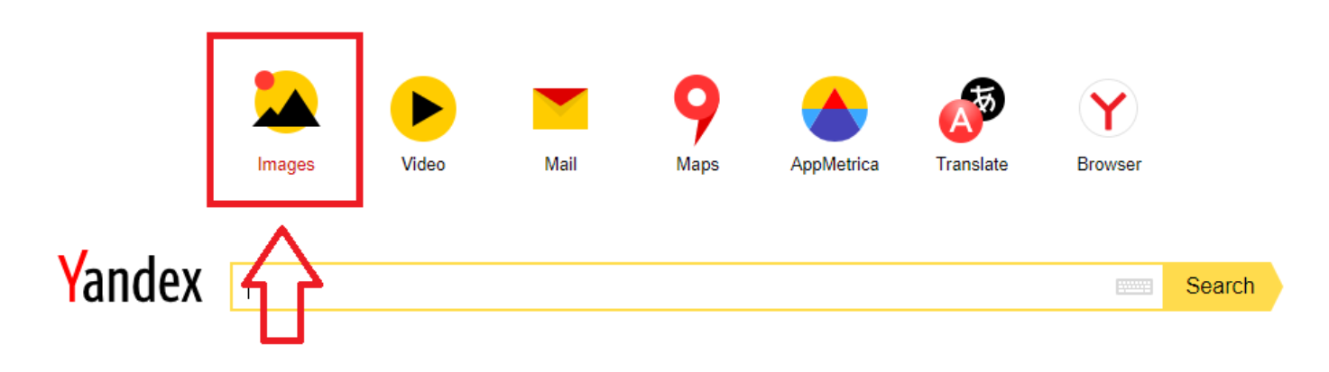

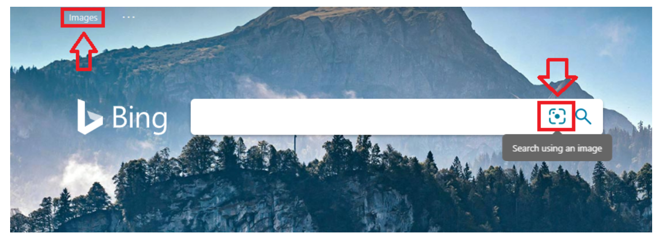

Osint technique: reverse image searching
Use: You have an image and you want to find all of the same, similar, or related images.
Notes:
First, up, reverse image searching. You use reverse image searching when you have an image (or a part of an image) and you want the search engine to show you matches on that image.
This is a great example of where it is helpful to understand the merits of the different platforms, especially those based outside the US.
For one that you might be less familiar with but which I would highly recommend you play around with - Yandex. Yandex is a Russian company. Yandex is the best for reverse image searching and is eerily good at facial recognition. It is best for content from Europe and former-Soviet countries but is worth a try for global content. Google and Bing are similarly good and often a good starting point due to the sheer volume of images they have access to. The unique thing about Bing is that it allows you to crop images and only search for the specific content in the crop which is handy.
TinEye looks for exact duplicates and is particularly good for brand-related identification because it is focused on IP violations.
If you want to move beyond the basics check out FindClone which can find you individual people.
https://www.bellingcat.com/resources/how-tos/2019/12/26/guide-to-using-reverse-image-search-for-investigations/
So, if you were to go into an interview and they were to hand you a picture of a field and they were to say “Based on this photo what can you tell me about the conflict going on in this region?” Your first response should be “Reverse image search.”
Similarly, if you were to join some sort of brand security team for a company you might want to use TinEye to understand who else is, perhaps, illegally using your company’s branding.

Slide 30
Google Dorking
Description: Using Google’s Search feature to the fullest of its abilities.
Use: You want to find a particular set of information on the internet via a search engine.
Dork | Purpose | Example
site: | Search only in the specified site. | CSET site:www.georgetown.edu
intitle: | Search for string in title across pages. | intitle:top-secret
filetype: ext: | Search for specific file types. | filetype:ppt
+word -word | Only search for items with exactly this word or excluding this word. | Georgetown -Texas - Christian - College
Notes:
Google hacking, also called Google dorking, is a fun way to say “fancy Google searches.” Google dorking leverages advanced operators to pull back more specific results from Google then you would get by just providing a general string as the query. To understand what advanced operators are available you can google resources which will provide an operator and a description of what it accomplishes. There are hundreds of these operators and we can’t go over them all now but to give a few examples of how this works. As Hoyas you may have experienced this situation where you met someone and told them you live in Georgetown and someone says, “I’m from Texas too!” And you are momentarily baffled. Through this you learn that there is a Georgetown, DC, a Georgetown, TX, and a George Town, Bahamas and of course a university of the same name. Let’s say you want to search the university’s website, typing in “Georgetown class” may or may not get you the results you want. Google dorks will make your life here easier, searching site: “georgetown.edu” class. Or, if you want to find a class in the town of Georgetown in Texas you might want to use “Georgetown class +Texas.” A few additional google dorks which are good entry level options to try include intitle and filetype. A fun one to try is to use intitle to try to find classified documents.
https://www.sans.org/security-resources/GoogleCheatSheet.pdf
Good video on this topic: https://www.youtube.com/watch?v=cFOBUYaxdWI

Slide 31
Project if you have time
Go on Georgetown’s website and either find more info about some of the people featured in those images or using Google dorks to see if you can find specific info on the site.

Slide 32
Operational Security
AKA “Loose lips sink ships.”

Slide 33
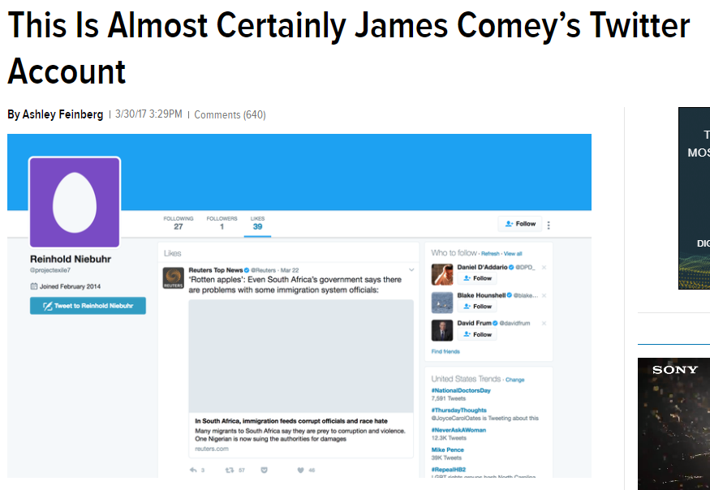
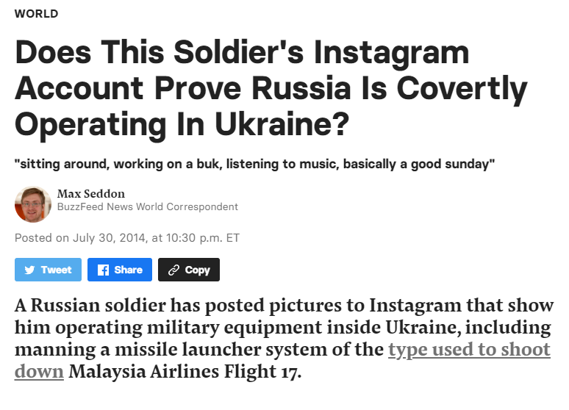
Operational security aka opsec
Operational Security, more commonly called OPSEC, encompasses the steps an investigator must take to ensure that they do not inadvertently reveal information about themself to an adversary.
Notes:
The term operations security was first coined in the U.S. military during the Vietnam War, as a result of an effort led by a team dubbed Purple Dragon. This team noticed that America's adversaries seemed to be able to anticipate their strategies and tactics. It was known that North Vietnam and the Viet Cong hadn't managed to decrypt U.S. communications and didn't have intelligence assets who could gather data from the inside; the conclusion was that U.S. forces themselves were inadvertently revealing vital information to the enemy. Purple Dragon coined the first military opsec definition: "The ability to keep knowledge of our strengths and weaknesses away from hostile forces."
Over time, the concept spread from the military to other U.S. government departments and into private industry, and was developed in more detail. [See article.]
OPSEC in the cyber domain encompasses the steps an investigator must take to ensure that they do not inadvertently reveal information about themself to an adversary. As investigators we may be seeking to identify OPSEC failures which an APT actor has made which might then be exploitable by us to further our investigation. The reality is that exploiting weaknesses in OPSEC is akin to a death by a thousand cuts. It’s typically not one “breadcrumb” of information that causes the damage; it’s the accumulated data over time that enables breakthroughs for an investigator. For example, let’s say an actor consistently makes it challenging to track their activity by doing their work via VPNs and rotating those connections regularly but one day they forget to do this and connect from their home IP address. Well, if we catch that and can then track the other activity coming off of that IP address this might be really helpful to our investigation and if separately the actor has inadvertently mentioned their spouse’s employer’s name then we might be able to stitch together this information to help law enforcement identify the physical address of the individual.
But similarly OPSEC is important to protect ourselves from inflicting harm on yourself through our investigations. Being constantly aware of the information you are sharing with individuals, third-parties, online entities, and employers, not to mention the extent this exposes you, is vitally important if you want to stay safe in today’s constant information battle.

Slide 34
Fun Project if you have time
There are individuals who have made a career out of exploiting OPSEC fails by people of interest and then reporting on what they have found.
Read up on Ashley Feinberg’s work. She does this routinely and is famous for having found FBI Director James Comey’s personal Instagram and Twitter accounts using publicly available information she gathered about him on social media.

Slide 35
Personal Security Basics
Think before you share
Understand what data is available on you online
Think before you record information about yourself on technology of any kind
Create compartments
Do NOT reuse passwords
Use two-factor authentication everywhere available
Have AV on your computer
Backup your data regularly
Use encrypted platforms
Ensure you have a custom password on your home wifi and change it every so often
Keep your devices patched!
Shutdown old and unused accounts
Notes:
Upholding basic cyber hygiene practices go a long way towards ensuring you maintain operational security. All of the items on this list are generally applicable to everyone but are particularly important for public persons and people who conduct high risk interactions online.
A part of my job on the Biden Harris Transition team which I am very proud of is that I had a team of individuals who conducted hundreds of personal account security sessions with all of the incoming political appointees into the administration. The topics covered were tactical walkthroughs of each of the items on this screen. To thoroughly walk through each of these, for a person familiar with the matter, it takes an hour or two. For people who have not done this work before it can easily take 4-8 hours. Do it. Take the time.

Slide 36
Personal Security Basics: Think before you share aka privacy
All of the information you can obtain about someone else via OSINT is all of the info about you that someone else can obtain by collecting OSINT against you.
Be aware of what you are sharing.
Determine your personal goals regarding public facing content and then go to your social media accounts and checkout the privacy settings available and update them accordingly.
Notes:
Upholding basic cyber hygiene practices go a long way towards ensuring you maintain operational security. All of the items on this list are generally applicable to everyone but are particularly important for public persons and people who conduct high risk interactions online.
A part of my job on the Biden Harris Transition team which I am very proud of is that I had a team of individuals who conducted hundreds of personal account security sessions with all of the incoming political appointees into the administration. The topics covered were tactical walkthroughs of each of the items on this screen. To thoroughly walk through each of these, for a person familiar with the matter, it takes an hour or two. For people who have not done this work before it can easily take 4-8 hours. Do it. Take the time.

Slide 37
Personal Security Basics: Think before you Record info on tech
We create a lot of passive data and many of us do not think about how organizations with access to that data use it to track our activities.
Examples:
Search history - you can regularly clear it
Cookies - you can regularly clear them
Data usage - log out of sites and apps when done using them and/or if you have an iPhone opt out of data tracking when not using the app.
Linked accounts - delete linked accounts you no longer use

Slide 38

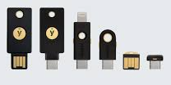

Personal Security Basics: Create Compartments
The two most significant things you can do to prevent your own accounts from being compromised are:
Do NOT reuse passwords
Use multi-factor authentication everywhere available
How to avoid password reuse:
Use a password manager and really commit to that lifestyle
But MFA is annoying!
Tough - deal with it - better than having your accounts liquidated
But also you can get yubikeys which are permanently on your device so that you don’t have to fumble to find them

Slide 39
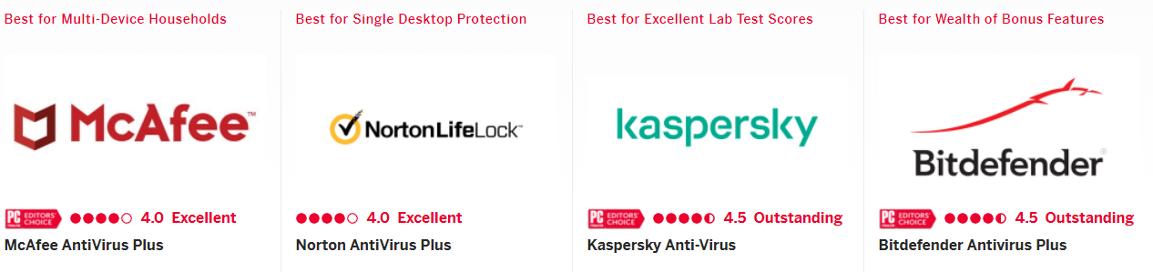
Personal Security Basics: USe AV
Run antivirus on your computer.
Pay attention when you get alerts and do something about them even if that something is bringing the device into Georgetown IT or Best Buy for support.

Slide 40



Personal Security Basics: Backup your data regularly
Backup your data all the time and/or use cloud native everything!
This will help you recover in the event of a ransomware event.

Slide 41




Personal Security Basics: Encrypted platforms
NSA joke - What’s the first rule of cryptography?
Look for cleartext.
End-to-end encryption is best.
Texts AND calls can be encrypted.

Slide 42
Personal Security Basics: Home wifi
Create a custom password on your home wifi and change it semiregularly.
Make sure your router is patched.
How?
Google your router make and ISP and there will be instructions for how to update your router.

Slide 43
Personal Security Basics: Keep your devices patched
Accept software updates ASAP. Like ASAP ASAP.
Software updates often include both new features AND security patches.
Every technology you own needs to be patched:
Phone
Laptop
Software
Apps
Nest
Router
Smart watch
Alexa / Google Home
All IOT devices

Slide 44



Personal Security Basics: Shutdown old accounts
Get rid of old accounts.
Do you know if your MySpace, AIM, or hotmail accounts are still active?
This may take persistence but assuming a company still exists they will likely have a mechanism through which you can reach out to request account closure.

Slide 45
Personal OPSEC advanced
Protect against SIM swapping
Go onto your phone company’s portal and opt-in to all security features including sim porting freezing
Protect against SWATTING
If you are or have any reason to believe you might become the target of online harassment call the non-emergency phone number of your local police department and let them know who you are and give them your cell phone number so that they can call you if they ever get a call which would prompt them to send a SWAT team to your house.
Remove your information from data aggregator sites
Research what information is available about you online and know that data brokers actively bundle information on groups of people and resell it to the highest bidder. You can manually request opt-outs from these sources or you can enroll in services such as DeleteMe which will process the requests on your behalf.

Slide 46
Opsec for security investigators
Use virtual machines
Use VPNs
Consider whether or not using TOR is right for you
Do not send operational messages from your personal phone - use a burner phone
Operate in the local time you are emulating
Do not click on malicious links unless you are in a secure test environment
Do not download or open malware unless you are in a secure test environment
Make purchases on gift cards not credit cards
Encrypt your harddrive, files, and drives
Notes:
A note on Tor:
Tor will provide you with a degree of anonymity by using an 128­bit AES (Advanced Encryption Standard). This encryption standard is breakable, however, not by your average bear so it is still a serious layer of protection. This is why, you should never send anything over Tor that you aren't comfortable sharing with the entire world unless you are using some sort of PGP encryption which we will talk about later. Communication from your computer, to the internet relies on an entry node which basically "enters your computer" into the Tor network. This entry node communicates with your computer, this entry node knows your IP address. The entry node then passes your encrypted request onto the relay node. The relay node communicates with the entry node and the exit node but does not know your computer's IP address. The exit node, is where your request is decrypted and sent to the internet. The exit node does not know your computer's IP, only the IP of the relay node. Using this model of 3 nodes it makes it harder, but not impossible to correlate your request to your original IP address. The problem comes obviously when you are entering plain text into TOR because anybody can set up an exit node. The FBI can set up an exit node, the NSA, or any other foreign government, or any malicious person who may want to steal your information. You should not be entering any sensitive data into any websites, especially when accessing them over TOR. If any of the nodes in the chain are compromised, and some likely are, and the people in charge of those compromised nodes have the computing power to decrypt your request, then you better hope it wasn't anything sensitive.
So what can we do to fix this? Well, use Hidden services. You can easily recognize these services by the address .onion. These services offer end to end encryption. The web server of the hidden service now becomes your exit node, which means the website you are visiting is the one decrypting your message, not some random exit node ran by a potential attacker. Remember, the exit node has the key to decrypt your request. The exit node can see what you are sending in clear text once they decrypt it. So if you are entering your name and address into a field, the exit node has your information. If you are putting a credit card, a bank account, your real name, even your login information, then you are compromising your identity.
Another step you can take, is to only visit websites that use HTTPS. You can tell if the website you are visiting is using HTTP Secure by the prefix at the beginning of the address. If you see https:// then your website is using HTTP Secure. What this does is encrypts your requests so that only the server can decrypt them, and not somebody eavesdropping on your communication such as a compromised Tor exit node. This is another form of end to end encryption. If somebody were to intercept your request over HTTP Secure, they would see encrypted data and would have to work to decrypt it.
Another reason you want to use HTTPS whenever possible, is that malicious Tor nodes can damage or alter the contents passing through them in an insecure fashion and inject malware into the connection. This is particularly likely when you are sending requests in plain text, but HTTPS reduces this possibility. HTTPS can also be cracked depending on the level of the key used to encrypt it. When you visit a website using HTTPS, you are encrypting your request using their public key and they are decrypting it using their private key. This is how cryptography works. A public key is provided to those who want to send an encrypted message and the only one who can decrypt is the one with the private key. Unfortunately, many websites today are still using private keys that are only 1,024 bits long which in today's world are no longer enough. So you need to make sure you find out which level of encryption the website you are visiting uses, to make sure they are using at a minimum 2,048, if not 4,096 bits. Even doing all of this unfortunately is not enough, because we have another problem. What happens if the web server itself has become compromised? Maybe your TOR nodes are clean, maybe you have used HTTPS for all your requests, but the web server itself of the website you are visiting has been compromised. Well then all your requests are again, as good as plain text.
Another component of OPSEC is using a Live Operating System and virtual machine setup. A live operating system is an operating system that you can run on top of your current operating system. So for example, if you are a Windows user, you have 2 choices. You can download the live operating system, burn it to a CD or DVD and then boot your computer from that DVD or CD. This will make sure your computer runs as if you have this operating system installed on your computer. However, if you remove the CD or DVD and reboot, then your computer will boot as normal. You can also use a USB drive to perform this same feature.
Secondly, you can run this live operating system in what's called a Virtual Box. The benefits of this are that you can run Windows simultaneously as you run this other operating system and you can easily switch back and forth between them without rebooting the computer. Both methods have their pros and cons. The pros of running a live CD boot, are that reduce the risk of having your computer compromised by viruses, malware and keyloggers that rely on Windows vulnerabilities to run.
Tails

Slide 47
Review from this session
New Data Types Fundamental Python constructs that define how data is stored and what can be done with it.
New Concepts Ideas, concepts, or other abstract processes for working with code. | Modules & Importing Code Functions Methods
New Operators Python foundational operators that take action on data.
New Keywords / Expressions Reserved keywords, statements, expressions, or other constructs for manipulating data. | Import Function Declarations, Calling Functions Calling Methods
New Functions Python’s general purpose way to call code to complete specific tasks
New Methods Code that belongs to specific object types that can be called on objects of the appropriate type.

Slide 48

Homework: Caesar Cipher Shift
The Caesar Cipher is a historic cipher that was used to encode messages. This construct is a very common coding challenge problem that you would be likely to see in an interview setting.
The task itself is for you to write two functions- one that performs an encode and one that performs a decode provided a number of letters to shift the alphabet forwards or backwards.
This is not an easy problem. It’s good practice for the midterm since it uses most of what we’ve covered so far. You may google for reference solutions but we recommend putting this off and trying it independently for as long as possible first - you do have everything you need to complete this puzzle with what we’ve covered. Be sure to follow the syllabus guides for reference material. For this assignment you cannot turn in someone else’s work purely with annotations.

